Slide 2
Consolidation point

Slide 3
Frontend
We've now looked at frontend, backend and integration so you have an awareness at least
HTML is easy, it's mainly a case of knowing the elements and attributes and these can be looked up
Basic CSS is easy, but you have seen how tricky it can get when dealing with page layout - especially if it is to be a responsive-layout (adapts to screen size) - e.g., using components like flexbox
Frontend development would usually use a framework like react, or styling templates like Bootstrap
GDS define look and feel for government products, so all this is learnt as you specialise on a project, but it is all built upon the html, css and JavaScript fundamentals
We haven't covered html forms but that's straight forward so we will cover when needed
Let’s have a quick look at Bootstrap for awareness
Bootstrap is a front‑end CSS framework that gives you ready‑made CSS classes (and JavaScript) for creating responsive layouts and components without writing everything from scratch
/html/bootstrap.html

Slide 4
Backend
We've used NodeJS and the Express web application framework
Java has Spring Boot (others are available)
Python has Flask (others are available)
We looked at creating an application server with various paths to executable code – business logic
We used middleware in implementing the static web server. We will look more at middleware later
So, you should now have a basic awareness of client-server architecture
Integration
We use http or https with appropriate http methods to call the endpoints
Headers are used to pass metadata from client to the server and server to client
Data is sent to the server either in the url or in the request body
GET and DELETE use the url as there is no data to send
POST, PUT and PATCH use the body to send data

Slide 5
Data encoding
We can send and receive data in multiple formats and encoding approaches
Formats include html, text, json, xml, binary
The client needs to let the server know the format of the data it is sending & visa versa - we state its type in the Content-Type header
Without the Content-Type header, the server has no idea how the sent data is encoded and will have to guess and maybe get it wrong or just ignore it.
This is the same situation when returning a response, so the browser knows the response data format. With the browser though, if the data looks like html or looks like json, or text the browser can make an educated guess
Server status code is also returned in a header - i.e. there are various headers transferring metadata in either direction
There are various Content-Types including:
application/x-www-form-urlencoded sent in key value pairs. key1=value1&key2=value2&key3=value3
get and delete will generally send this as part of the url
post, put and patch will generally send it in the body
text/plain, text/html, text/css, text/xml
application/javascript, application/json, application/xml
Binary formats: application/octet-stream(raw binary), image/png, image/jpeg, image/gif, image/webp, video/mp4, audio/mpeg, font/woff2, application/pdf, application/zip

Slide 6
We haven’t worried much about the Content-Type so far, but you need to be aware of it
When sending data from the browser, the default is application/x-www-form-urlencoded
When sending from JavaScript it tends to be application/json so you need to set the header for this
fetch("/person", { method: "POST", headers: { "Content-Type": "application/json" }, body: JSON.stringify({ fName: "Tony", lName: "Nicol", age: 40 }) });
You can use name:value pairs and application/x-www-form-urlencoded if you want to but json is more common for JavaScript fetch operations
From the server perspective, the respons function often sets the Content-Type header
res.send: inspects the data type and sets the header based on the format of the data - or you can set it to be sure
res.setHeader("Content-Type", "application/json");
res.json stringifies the object and sets the header to Content-Type: application/json; charset=utf-8
There are others but these are these ones we have used

Slide 7
HTML Form
We can look at all this in a demo and cover the form element as well
A form element can wrap input elements. When a button of type submit is pressed, the form collects all the values from all the elements on the form and associates them with their element names to form a list of name:value pairs
An action attribute specifies the destination, and a method attribute specifies which http method to use
<form action="/person" method="post" enctype="application/x-www-form-urlencoded">
The input elements work with the form by providing an optional required attribute which if set will prevent the form sending data if the element has no value from the user
/API/all_http_methods_demo

Slide 8
JavaScript Message Handling
Due to the single thread, executing a lengthy function will freeze the UI
To avoid this, we can use asynchronous functions to sort of multi-thread
The asynchronous function is suspended so the main thread can continue
The asynchronous functionality in the background runs in C on threads within C, not JavaScript
Once complete, the asynchronous function adds a callback to the event queue
We need a diagram for this …

Slide 9
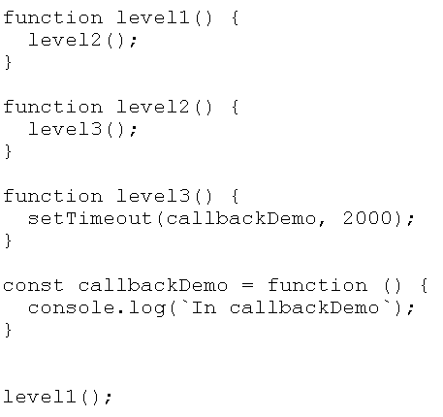
Call Stack (LIFO)
APIs
CheckboxClick
callbackDemo
ButtonClick
Fetch
AudioData
console
crypto
+ hundreds more
Message Handler
Event queue (FIFO)
ButtonClick
CheckboxClick
callbackDemo

Slide 10
Asynchronous approaches
We've seen how callback functions like setTimeout work in JavaScript to make an async call
But, multiple callbacks within callbacks can get quite complex, especially in error conditions, so the concept of a promise, was added to the language. Callbacks are still used
A further addition to the language is async and await. These further simplify the coding of asynchronous operations using promises
Callback, promise and async / await are a little tricky to get your head around at first and are areas that interviewers often ask about to differentiate basic JavaScript programmers from those with an understanding of asynchronous operations handled by these JavaScript language features
To reiterate: a callback is a function which is passed to another function as an argument. The function "registers" the callback. i.e. it notes the function's execution address. If the function is asynchronous, when the main function, e.g. fetch or setTimeout, is ready, e.g., reading data from a file or database or whatever it is that's likely to take time, it will pass the registered callback function to the event queue to be executed when the thread is available. Using a promise is just a syntactically better way of achieving the same result
If the callback is not asynchronous, when the parent function is ready, it will execute the callback synchronously

Slide 11
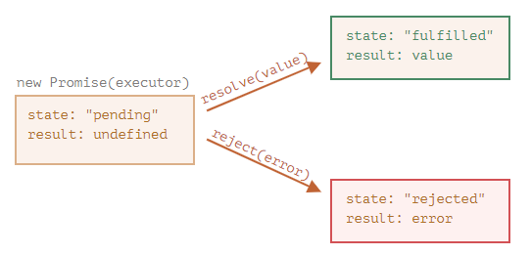
Promises
A promise is called that because it is a promise, agreed now, but to do something later. A promise is an object with two key properties: state and result. It has three states: pending, fulfilled or rejected. Whilst it waits for an asynchronous event to complete, it has a status of “pending”. This is just a newer way of implementing asynchronous operations instead of callbacks
We can create promise-based code and we use promise-based code from others
Notes:
Graphical sequence of promise 1 on next slide
The promise methods are documented here: https://developer.mozilla.org/en-US/docs/Web/JavaScript/Reference/Global_Objects/Promise

Slide 12
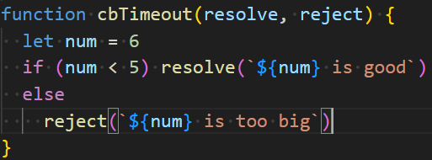
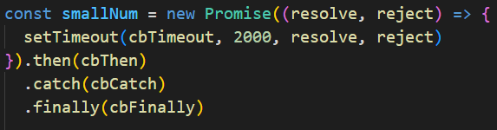




Written using full functions to illustrate sequence
Typically use arrow functions
Typically create promise in a function
demos/async/promise1.js
demos/async/promise1b.js

Slide 13
Async /Await
Promises were introduced to simplify callbacks but they are still not particularly intuitive as code is executed out of sequence so you need to think differently when dealing with asynchronous processing. Async / await has been introduced to simplify things even more by enabling you to make the code look more like synchronous code
A promise needs to be set into a state from pending to have its .then() or .catch() function callback called to handle the response to the asynchronous event. Async / await enables some, arguably better readability by enabling the result of the async function to be dealt with in what looks like a more synchronous manner. Async / await uses promises but is abstracted further from the detail
Async/await is an option, not a replacement – there are situations where you may prefer to use one over the other, or both - it’s up to you
Many library functions now support promises - fetch is one of them
Note: to be able to await a response, await must be within an async function

Slide 14

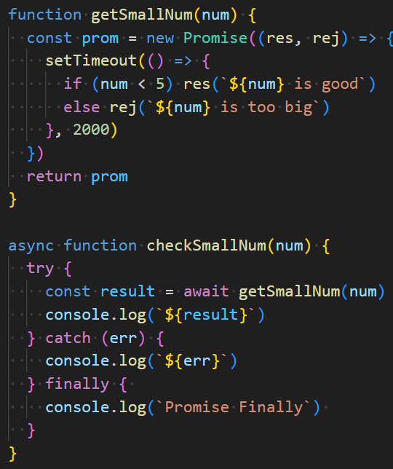
Immediate execution of the callback
Reg timer callback - not executed
Continue with main whilst waiting
When promise resolved, continue with suspended code
Call function returning promise
Needs to be async to use await
Return pending - wait
Pending
Resolved
Rejected
Looking at the same example
Still uses a promise but async await syntax
Do this regardless
demos/async/asyncAwait1b.js

Slide 15
Note: if you’re a detail person, there is also a microtask queue:
JavaScript uses an event loop to manage asynchronous operations. It has two main queues:
Microtask queue:
Includes: Promise callbacks (.then, .catch, .finally) and a few others (e.g. fetch()).
These are all processed immediately after the call stack clears, before any macrotasks
Macrotask queue (task queue or event queue on the diagram)
Includes: setTimeout(), setInterval(), I/O, UI events
Scheduled to run after all microtasks have been processed
Because only one macrotask runs per loop tick, and microtasks always run first, a large number of microtasks or long-running synchronous code can delay UI updates and make the interface appear frozen
Practical comparison of async/await and .then .catch for API access in the following demos
/api/basic/jokes.html
/api/basic/jokes2.html

Slide 16
Promise Practical Use-case
Open a file asynchronously as it may be a slow process
On the plus side, this won't hog the thread
On the downside you basically need to wrap the rest of the whole program into the callback
Async / await and promises still execute out of sequence but are much more readable
Let's look at some examples
demos/files/traditional-fail1.js
demos/files/traditional-fail2.js
demos/files/traditional-pass.js
demos/files/file-promise1.js
demos/files/ file-promise2.js
demos/files/ file-sync.js

Slide 17
Express and Middleware

Slide 18
Browser
req obj assigned parsed url,headers, method and more (not body)
Middleware Stack
Path | Method | Reference
'/' | null | .json
'/' | GET | rootPath
'/results' | GET | allResults
'/results' | POST | addStudents
'/results/name' | GET | resultsByName
'/results/:id' | GET | resultsById
req, res
Express
.json(req,res,next())
search
Yes
resultsByName(req,res)
3000
...:3000/results/jim
http response
/demos/API/simpleAPI
Notes:
The middleware functions appear on the stack in the order they are defined
Each is checked in order and if they don't terminate, call next to keep the search going
The putOnly middleware isn't special, it is called for all methods but the called function only responds if the method it PUT
The /nama/:name is different. As the middleware only applies to it, it is added into the stack array element object and called before the path. There could be any number of these passed as parameters in the path and they will be stacked in order from left to right

Slide 19
Express Middleware
Middleware in this context is basically functionality that you have written or library packages that can be added to a call list (middleware stack) and have access to req and res
Middleware is added to the middleware stack, typically using app.use() to add a function to the middleware stack
Middleware is called in the order it appears on the stack. If a middleware completes, e.g., res.send() none of the others are called. However, middleware functions, if they can't complete the job, or they do something en-route to an endpoint, maybe add some stuff to the req or response object they need to call next() to pass control to the next middleware in the list etc.
We won't get involved in anything complicated but will add some middleware that gets called before our route for pre-processing then generally pass control to the route's callback function to complete with a res.send() or similar
The middleware stack has middleware added to it in the order it appears in the source file so be wary of that
Notes:
Run the example
Explain it
Explain it again in the context of the diagram on the next slide that shows where middleware could go
Show that static will find a file and res.send it so close the search - otherwise it continues looking for a match

Slide 20
Browser
req obj assigned parsed url,headers, method and more (not body)
Middleware Stack
Path | Method | Reference
'/' | null | checkPassword
'/' | null | logger
'/' | null | putOnly
'/' | null | anonymous
'/' | GET | anonym ref
'/login' | GET | anonym ref
'/name/:name' | PUT | logParam anonym ref
* | POST | anonym ref
* | null | Anonym ref
req, res
Express
checkPasword(req,res,next())
Yes
search
3000
...:3000/jim
logParam(req,res,next())
http response
/demos/API/middleware-intro
/demos/API/middleware
Notes:
The middleware functions appear on the stack in the order they are defined
Each is checked in order and if they don't terminate, call next to keep the search going
The putOnly middleware isn't special, it is called for all methods but the called function only responds if the method it PUT
The /nama/:name is different. As the middleware only applies to it, it is added into the stack array element object and called before the path. There could be any number of these passed as parameters in the path and they will be stacked in order from left to right

Slide 21
The middleware functions appear on the stack in the order they are defined
Each is checked in order and if they don't terminate, call next to keep the search going
The putOnly middleware isn't special, it is called for all methods but the called function only responds if the method it PUT
app.use('/login', checkPassword) example, adds checkPassword to the /login route for ALL methods
The /name/:name is different. As the middleware only applies to it explicitly, i.e. PUT /name/:name, it is added into the stack array element object and called before the path and on completion calls the route function by calling next(). There could be any number of these middleware functions passed as parameters in the path and they will be stacked in order from left to right
The middleware can modify the content of the request and response objects that it passes on
Notes:
Notes: expressMiddlewareNotes
in folder videos/middleware
Do html / css session in lab or tutorial. e.g. use F1 example of a static page

